Slide 1
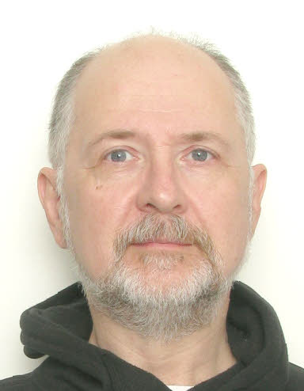
Extreme Objects
Alexey Kanatov, alexey.v.kanatov@gmail.com
LinkedIn
May 2023

Slide 2
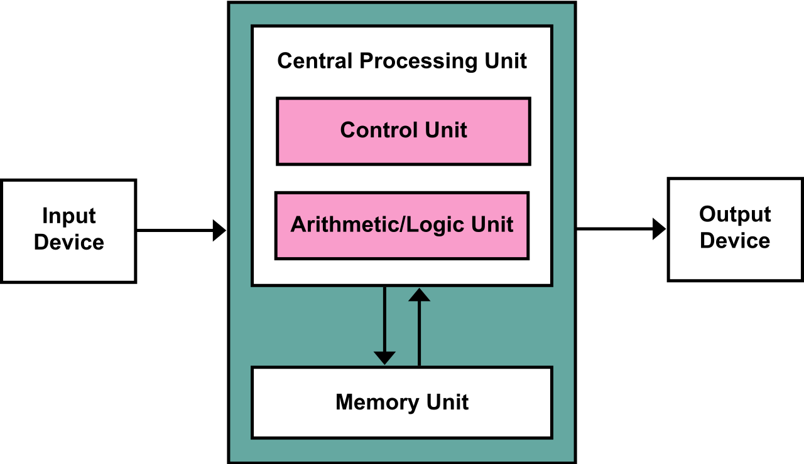
Content
Introduction
Key definitions, object structure
Object life cycle
Object examples
Summary

Slide 3
Introduction
What kind of computers do we have? Processor+memory model
Memory structure – set of cells with an address per cell. Cell is an ordered set of bits – here comes binary digits 0 and 1
Ordered set of QWORDS, DWORDS, WORDS, BYTES, bits
Object – region of the computer memory. Its logical structure is most cases different from the memory structure
Set of named(numbered) attributes
…
PU₁
PU_{n}
Memory₁
Memory_{n}
00001101010101
11100101010101
10101010101010
00110101011101
11001100110001
name: “Alexey V. Kanatov”
age: 55
Address: Moscow
Company: ref to Huawei.Object
Note: set is not ordered implies (name:”A”,age:66) is equal to (age:66, name:”A”)

Slide 4
Introduction
Everything is an object. That is why term object is the essential one. Set of operations on objects is fixed; object life cycle has just 3 stages; object immutability is defined. Term attribute is introduced as it is a key part of any object internal structure. Relations between objects are defined. Two atomic objects are introduced as an introduction to constant objects concept. What is class type in the object world? Brief introduction into active objects concept is given.
Pure object-oriented approach to programming. Everything is an object – code, data, and functions. Minimalistic approach based on unification allows keeping minimal basis of key concepts for clarity and conciseness of the approach. It covered both passive and active behaviors of objects (sequential and concurrent executions) as well as approaching to the fully verified software using structured assertions. Proper type definition which comes from objects, multiple-inheritance with conflicts and multiple overriding coexists with simple atoms as 0 and 1 which are the foundation of everything
Extreme objects
Summary: This set of lectures gives full introduction into pure object-oriented approach to programming. Everything is an object – code, data, and functions. Minimalistic approach based on unification allows keeping minimal basis of key concepts for clarity and conciseness of the approach. It covered both passive and active behaviors of objects (sequential and concurrent executions) as well as approaching to the fully verified software using structured assertions (extended Design by Contract (c)). Proper type definition which comes from objects, multiple-inheritance with conflicts and multiple overriding coexists with simple atoms as 0 and 1 which are the foundation of everything
Lecture 1: Introduction to objects. Object structure. Attributes and fields
Examples of objects. Definition of object term. 0 and 1 as the only two basic objects
Relation between computer memory and objects
Key characteristics of any object. Object structure. Attributes. Kinds of attributes. Data and actions
Object life cycle
Object creation and attributes initialization
Life time loop – activations
Destruction
Lecture 2: Object operations. Object equality. Object immutability. Relations between objects
How to compare objects?
How to convert objects into each other? Convertibility
What can be immutable? Shallow and deep immutabilities
Refers and includes. Reference and value semantics. No cycles
Lecture 3: Group of objects form a type. Introduction of type concept
Objects with identical structure form a type
Special case of constants of different kinds
Persistence of objects. Backbone of dynamic loading
Kinds of type parametrization. Genericity
Lecture 4: Object-class-module-type hierarchy
Compile time and runtime relations
Class-module difference and commonality
Kinds of types
Lecture 5: Inheritance, overriding and member adaptations. Overloading
What is inheritance? Do we need the top?
What is member adaptation while inheriting?
Kinds of overriding. Function to variable or constant
Conformance
Overloading: names – attributes and classes
Resolving ambiguities
Lecture 6: Systematic assertions and kernel types
Predicates. Kinds of predicates
Preconditions, postconditions, invariants and variants
Alignment with inheritance
Implications for practical usage. No more issue root cause triaging
Constant objects and regular expressions
Lecture 7: Active (concurrent) objects. Interactions between them
Concept of processing element – thread, process, service
Active objects never sleep
How to support synchronous and asynchronous interactions between objects
Lecture 8: Control structures
Member activation
Assignment is a kind of special case
Conditional
Loops
Exceptions. Kinds of exceptions
Block
Integration with assertions
Lecture 9: Tuples as a basic concept
What is a tuple
Every routine has 1 parameter
Array vs. tuple
Conformance
Lecture 10: Compilation units and separate compilation
Kinds of compilation units: script, program and library
Clusters as areas for search
Names’ controls
Concept of the compilation context

Slide 5
Basic terms
Object is a set of attributes. Objects with identical set of attributes’ kinds form a type which is described by class
Class is … a named collection of members (features, characteristics)
Member can be routine (function) or attribute (field)
Routine can be procedure (action, command) or function (query)
Attribute (query) can be variable or constant
Another view: there are only attributes – variable or constant (assigned once). Actions (routines) are just constant attributes of the function type
Origin is the class the member was initially declared
Seed is the initial member declaration in the origin class
Inheritance – relation between classes implying all members of every parent ‘go down’ to the child class. Base-derived, supertype, extension – no need to step into terminology discussion
Version of the member – in some class we may have several versions – coming from the same origin&seed under the same or different names, form different ones under the same name

Slide 6
Foundations (I): inheritance basics
1.
2.
A
A
foo
foo
B
B
*foo
class A
foo
end
class B inherit A
end
class A
foo
end
class B inherit A
override foo
end
foo$A
Class | Version
A | foo@A
B | foo@A
Class | Version
A | foo@A
B | foo@B
foo$A

Slide 7
Foundations (II): no replication, but merge
3.
A
/* There could be many paths from B to A, with many classes on all these paths */
class A
foo
end
class X inherit A
end
class B inherit A, A, X
end
foo
B
foo$A
Class | Version
A | foo@A
X | foo@A
B | foo@A

Slide 8
Foundations (III): kill many birds with one stone
4.
A
B
foo
foo
class A
foo
end
class B
foo
end
class C inherit A, B
override foo
end
C
*foo
Class | foo$A | foo$B
A | foo@A
B |  | foo@B
C | foo@C | foo@C

Slide 9
Foundations (IV): kill many birds with one stone
5.
A
B
foo
foo
*foo
class A
foo
end
class B
foo
end
class C inherit A, B
override B.foo
end
C
Class | foo$A | foo$B
A | foo@A
B |  | foo@B
C | foo@B | foo@B

Slide 10
Foundations (V): generalization, no replication, kill many birds with many stones
f₁ .. f_{k}
f_{k+1} .. f_{l}
f_{l+1} .. f_{m}
f_{m+1} .. f_{n}
P₁
P_{r}
Sic: ‘f’ is the name
*P₁.f₁ .. *P_{ox}.f_{o2}
C
*f₁ .. *f_{o1}
single
f
overloading
f_{k+1}..f_{l}
overriding
f₁..f_{o1+o2}

Slide 11
Foundations (VI): any graph can be presented as the incidence matrix
 | s$O₁ | s$O₂ | s$O₃ | … | s$O_{m}
C₁ | v@C₁₁
C₂ |  | v@C₂₂
C₃ | v@C₁₃
…
C_{n} | v@C_{1n} |  | v@C_{3n}
this ->
matrix is sparse!
matrix contains addresses for routines and offsets from this for fields
inheritance graph has the sink – Any (Object)
treat this matrix as rows – VMT-like approach, vector indexed by origin$seed ID (1 .. m) –> direct access to EA (effective address)
treat this matrix as columns – MST approach, vector indexed by object class ID (1 .. n) –> direct access to EA

Slide 12
Foundations (VII): any member activation will look like
// Source code
target1.foo ()
target2.field1 := target3.field2
// Pseudo-asm code: row view
call target1[foo:seed$origin]
load target3[field2:seed$origin], #R1
store #R1, target2[field1:seed$origin]
// Pseudo-asm code: column view
call foo:seed$origin [target1]
load field2:seed$origin [target3], #R1
store #R1, field1:seed$origin [target2]
there will be difference in number of instructions and their nature for row and column based approaches for real assemblers! Rows are better
matrix is sparse – how to keep direct access and get rid of empty cells

Slide 13
Foundations (VIII): can we optimize the matrix?
Remove rows – no objects of the class at runtime
Abstract classes
Class does not belong to dynamic class sets (needs full program analysis)
Empty cells – particular version is never activated (fields caveat)
Dead-code elimination in case of OOP (needs full program analysis)
Remove columns
The same non-empty value in the column
Assume we did all that –> what’s next –> to reorganize the matrix

Slide 14
General algorithm: demo
Any₁
A₃:f1
B₃:*f1,f2
H₂:f3
J₂:f4
C₀
D₀:*f2
E₂:f1
I₁:*f3
K₀:*f4
*f3
*f1
F₀
G₀
* - stands for override in class or while inheriting
X_{n} – means number of children the class has
Sort by number of children at every level

Slide 15
General algorithm: steps
#-1, Any₁
#0, A₃
#1, B₃
#7, H₂
#9, J₂
#2, E₂
#5, C₀
#6, D₀
#8, I₁
#10, K₀
#3, F₀
#4, G₀
Numerate classes starting from 0
Abstract or ‘objectless’ class will get -1

Slide 16
General algorithm: columns outcome
 | f₁$A | f₂$B | f₃$H | f₄$J
#0, A | f₁@A
#1, B | f₁@B | f₂@B
#2, E | f₁@E | f₂@B | f₃@H
#3, F | f₁@E | f₂@B
#4, G | f₁@A | f₂@B | f₃@H | f₄@J
#5, C | f₁@B | f₂@B
#6, D | f₁@B | f₂@D
#7, H | f₁@A |  | f₃@H
#8, I | f₁@A |  | f₃@I | f₄@J
#9, J | f₁@A |  |  | f₄@J
#10, K | f₁@A |  |  | f₄@K
Columns’ view: no empty cells, no direct access
f₁$A:
A, G, H, I => f₁@A,
B, C, D => f₁@B,
E, F => f₁@E
f₂$B:
B, E, F, G,C=> f₂@B,
D => f₁@D
f₃$H:
E, G, H => f₃@H,
I => f₃@I
f₄$J:
G, I, K => f₄@J,
K => f₄@K

Slide 17
General algorithm: columns outcome
 | f₁$A | f₂$B | f₃$H | f₄$J
#0, A | f₁@A
#1, B | f₁@B | f₂@B
#2, E | f₁@E | f₂@B | f₃@H
#3, F | f₁@E | f₂@B
#4, G | f₁@A | f₂@B | f₃@H | f₄@J
#5, C | f₁@B | f₂@B
#6, D | f₁@B | f₂@D
#7, H | f₁@A |  | f₃@H
#8, I | f₁@A |  | f₃@I | f₄@J
#9, J | f₁@A |  |  | f₄@J
#10, K | f₁@A |  |  | f₄@K
EA = this -> class ID + MST -> shift
Direct access + some address arithmetic burden
1
2
0
4

Slide 18
General algorithm: rows outcome
 | f₁$A | f₂$B | f₃$H | f₄$J
#0, A | f₁@A
#1, B | f₁@B | f₂@B
#2, E | f₁@E | f₂@B | f₃@H
#3, F | f₁@E | f₂@B
#4, G | f₁@A | f₂@B | f₃@H | f₄@J
#5, C | f₁@B | f₂@B
#6, D | f₁@B | f₂@D
#7, H | f₁@A |  | f₃@H
#8, I | f₁@A |  | f₃@I | f₄@J
#9, J | f₁@A |  |  | f₄@J
#10, K | f₁@A |  |  | f₄@K
Rows’ view: empty cells, direct access
‘Smart’ rows’ view - 2 kinds of vectors:
Fast – fully filled, direct access
Compact – no empty cells, no direct access
H:
f₁$A => f₁@A,
f₃$H => f₃@H
Delta to switch from Fast to Compact

Slide 19
Indication of potential dynamic class loading case
Pattern of class loading
foo (<parameters>): ReturnType foreign
What to be stored in meta and what to be rebuilt?
 | f₁$A | f₂$B | f₃$H | f₄$J
#0, A | f₁@A
#1, B | f₁@B | f₂@B
#2, E | f₁@E | f₂@B | f₃@H
#3, F | f₁@E | f₂@B
#4, G | f₁@A | f₂@B | f₃@H | f₄@J
#5, C | f₁@B | f₂@B
#6, D | f₁@B | f₂@D
#7, H | f₁@A |  | f₃@H
#8, I | f₁@A |  | f₃@I | f₄@J
#9, J | f₁@A |  |  | f₄@J
#10, K | f₁@A |  |  | f₄@K
One new class:
One new row
Potentially several new columns
Aim: no difference between access to objects of classes known at compile time and ones loaded dynamically

Slide 20
Summary
Incidence matrix class vs. seed&origin represents well the whole inheritance graph. It is the central data structure for analysis and optimizations
Classes numbering scheme based on the nature of the inheritance graph and seed&origin numbering scheme based on the length of the column vectors delivers blocked matrix which supports direct access with minimal memory losses to store empty cells
Dynamic loading of new classes enforces keeping meta information to rebuild the matrix and regenerate a lot of code in the worst case

Slide 21
Thank you ! Q&A

